Slide 1

THANK YOU FOR DOWNLOADING!
Hope it helps with your presentations!
In case the embedded fonts don’t work, here are the download links:
Inter
https://fonts.google.com/specimen/Inter
Covered By Your Grace https://fonts.google.com/specimen/Covered+By+Your+Grace

Slide 2

ANTIFRAGILE
LE SSERAFIM
@DSTORYCO
POWERPOINT TEMPLATE
AGENDA
Be prepared for loss
Change your perspective towards stress
Overcompensate when resolving problems

Slide 3

ANTIFRAGILE
HOW TO BECOME

Slide 4
HYDRA
LIVE LIKE A
BUILD RESILIENCE AND GET STRONGER WHEN THINGS ARE CHAOTIC

Slide 5









1. BE EMOTIONALLY PREPARED FOR LOSS
SET YOURSELF UP TO BE READY FOR ANY BAD SITUATION.
REHEARSING YOUR LOSS OR THE CHAOS YOU MAY HAVE BEEN DREADING TO FACE.

Slide 6


2. CHANGE YOUR PERSPECTIVE TOWARDS STRESS
INSTEAD OF EASING STRESS, WELCOME IT AS IT HELPS IGNITE YOUR PASSION AND PRODUCTIVITY
E.G. TRYING ON A NEW SPORT, STARTING A NEW PROJECT, OR ANSWERING CHALLENGING TESTS.

Slide 7






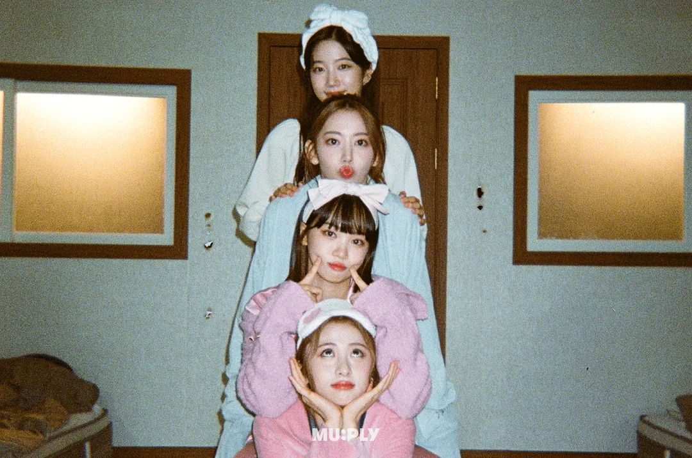




3. Overcompensate
when solving problems
Put more work into improving yourself or handling things more effectively, so that you can be more prepared in handling any challenge that might come

Slide 8





ASSETS

